Slide 1


Twitter Sentiment Analysis
Galgotias University
UJJWAL TIWARY
Anurag Khaiwal
Harsh Kumar Singh

Slide 2
What is the Twitter Sentiment Analysis.
Sentiment Analysis is a technique used in text mining. It may, therefore, be described as a text mining technique for analyzing the underlying sentiment of a text message, i.e., a tweet. Twitter sentiment or opinion expressed through it may be positive, negative or neutral. However, no algorithm can give you 100% accuracy or prediction on sentiment analysis.
As a part of algorithms like SVM, Naive Bayes is used in predicting the polarity of the sentence. sentiment analysis of Twitter data may also depend upon sentence level and document level

Slide 3
Problem Statement
In this project, we try to implement a Twitter sentiment analysis model that helps to overcome the challenges of identifying the sentiments of the tweets. The necessary details regarding the dataset are:
The dataset provided is the Sentiment140 Dataset which consists of 1,600,000 tweets that have been extracted using the Twitter API. The various columns present in the dataset are:
1) target: the polarity of the tweet (positive or negative)
2) ids: Unique id of the tweet
3) date: the date of the tweet
4) flag: It refers to the query. If no such query exists then it is NO QUERY.
5) user: It refers to the name of the user that tweeted
6) text: It refers to the text of the tweet

Slide 4
Purpose of the project
Sentiment analysis refers to identifying as well as classifying the sentiments that are expressed in the text source. Tweets are often useful in generating a vast amount of sentiment data upon analysis. These data are useful in understanding the opinion of the people about a variety of topics.
Therefore we need to develop an Automated Machine Learning Sentiment Analysis Model in order to compute the customer perception. Due to the presence of non-useful characters (collectively termed as the noise) along with useful data, it becomes difficult to implement models on them.
In this article, we aim to analyze the sentiment of the tweets provided from the Sentiment140 dataset by developing a machine learning pipeline involving the use of three classifiers (Logistic Regression, Bernoulli Naive Bayes, and SVM)along with using Term Frequency- Inverse Document Frequency (TF-IDF). The performance of these classifiers is then evaluated using accuracy and F1 Scores.

Slide 5
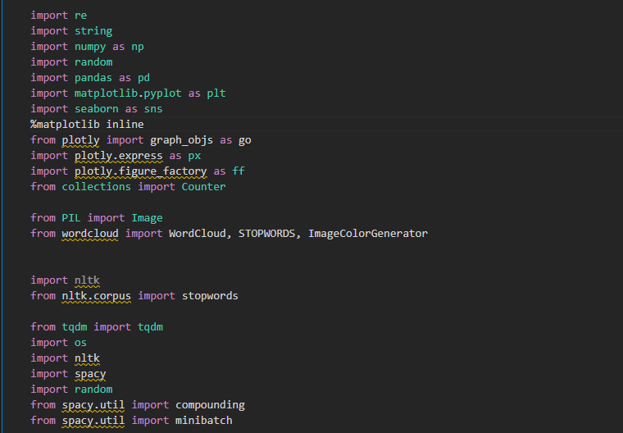
Data Procurement and Data sources
Importing Necesseties

Slide 6
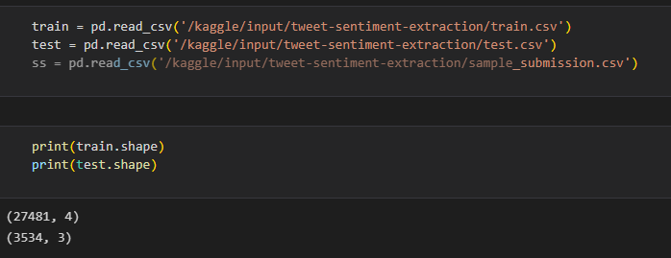
2) Reading the Data

Slide 7
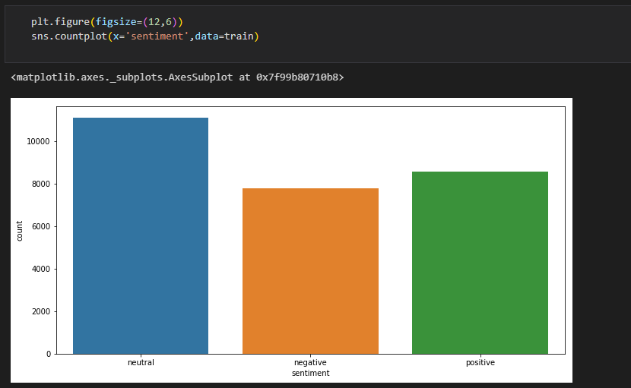

Slide 8
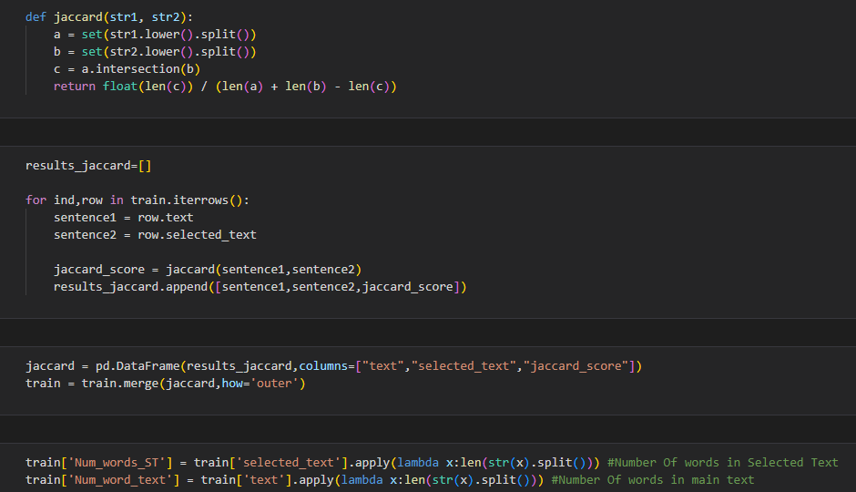
Generating Meta-Features

Slide 9
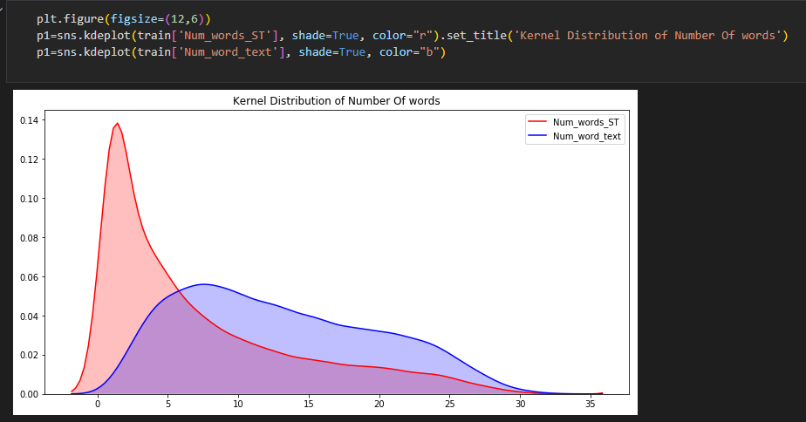
Data Analysis and Findings

Slide 10
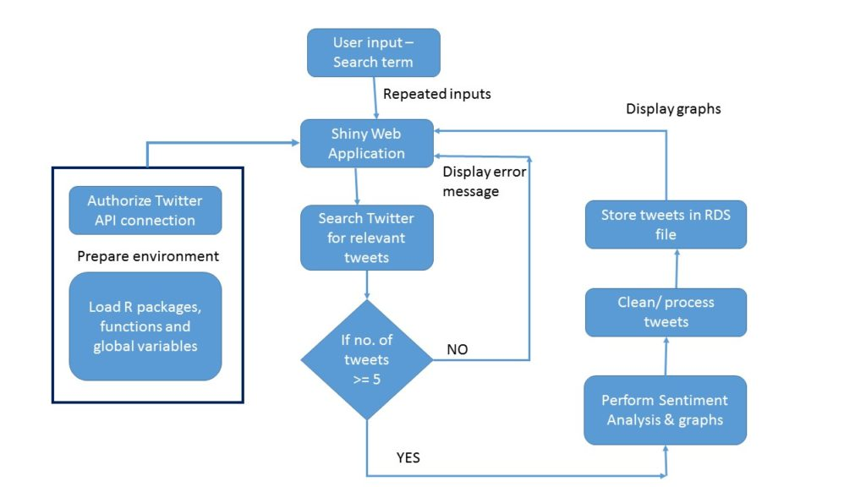
Twitter Sentiment Analysis flowchart

Slide 11
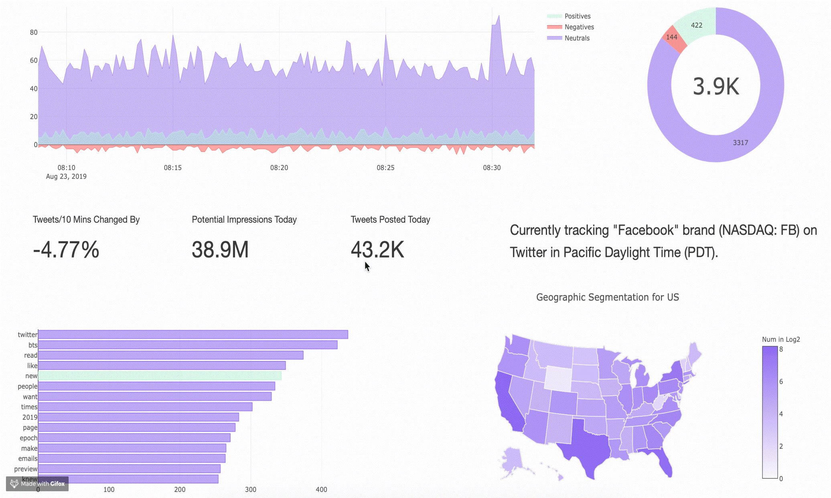
Data Visualization charts and graphs

Slide 12
Conclusion
Upon evaluating all the models we can conclude the following details i.e.
Accuracy: As far as the accuracy of the model is concerned Logistic Regression performs better than SVM which in turn performs better than Bernoulli Naive Bayes.
F1-score: The F1 Scores for class 0 and class 1 are : (a) For class 0: Bernoulli Naive Bayes(accuracy = 0.90) < SVM (accuracy =0.91) < Logistic Regression (accuracy = 0.92) (b) For class 1: Bernoulli Naive Bayes (accuracy = 0.66) < SVM (accuracy = 0.68) < Logistic Regression (accuracy = 0.69)
AUC Score: All three models have the same ROC-AUC score.
We, therefore, conclude that the Logistic Regression is the best model for the above-given dataset.
In our problem statement, Logistic Regression is following the principle of Occam’s Razor which defines that for a particular problem statement if the data has no assumption, then the simplest model works the best. Since our dataset does not have any assumptions and Logistic Regression is a simple model, therefore the concept holds true for the above-mentioned dataset.

Slide 13


